Slide 1
Prototype for a BI Solution for Lupita’s Cafe
Notes:
Greetings and welcome to this presentation.My name is Stefanos Stefanou , and today with my co-presenter Nickolas Dimitriou we will present a prototype Business intelligence solution that we created for Lupita’s café.
Our goal is to demonstrate the value and the data-driven insight that a BI solution will bring into the organisation,

Slide 2
Table of Contents
Generation of the data
Dashboards and Storytelling
01
02
03
Conclusion
04
Lessons learned
In this section we would describe the generation of the 2020 dummy data
In this sections we are going to show the dashboards and explain the process
In this section we are going to provide the closing points
In this section we will present what we learned
Notes:
We have split our presentation into 4 main topics, Firstly, we will talk about the 2020 mocked data generation process, Secondly we will talk about our findings and our proposed dashboards for the two required levels, (C and Managerial). Thirdly we will conclude the assessment, by discussing some points of interest, and lastly we will briefly talk about the lessons learned from this assessment

Slide 3
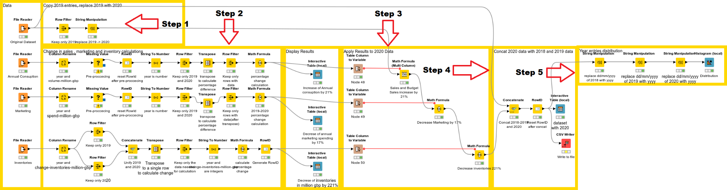
Generation of the data
Calculations applied:
Sales and Budget sales were increased by 21%
Marketing was decreased by 17%
Inventory was decreased by 221%
Notes:
Let’s start with how the 2020 mocked data were generated. In order to make our prototype more realistic and as accurate as possible, mocked data were created that will presumably reflect the 2020 values.
To create this data, we first researched the impact that coronavirus had on the food retail industry in 2020.
Using various statistics, presumably coming from the office of national statistics, we found that
Sales were increased by 21%
We assume that organisation remained consistent on calculating budgets, so budget also increased +21%
Marketing spending was decreased by 17%
Inventory was decreased by 221%
We assumed that negative inventory didnt affect sales
Therefore we decreased the respective variables by the aforementioned percentages.
Looking at the graph,
In Step 1: Is where the data were imported, and 2019’s data were duplicated as 2020’s data
In Step 2 and 3: We added the data that were collected from our research about the sales, marketing and inventory, and after we applied some transformations, to make them compatible with the given dataset, we performed the percentage change calculation in the affected fields.
In Step 4: we concatenated the 2020 data with the given dataset, and exported the result in a new CSV file.
In Step 5, we applied some test statistics into the end-result, to ensure data quality and consistency
When generating the 2020 dummy data, a few assumptions for simplicity had to be made
1. Inflation was not taken into account.(7% for 2020)
2. 2020 is a leap year, and 2019 was not.
3. The aforementioned percentages were applied for the whole year, and not month-per-month basis.

Slide 4
Dashboards and Storytelling
Topics
Section 1 - Current State
Section 2 - Trends
Section 3 - Forecast
Section 4 - What if
Two dashboards
One for C level
One for Managerial level
Notes:
Given that the C level managers are of a very tight schedule, we designed different dashboards for them, with reduced level of detail, coming in no expense however on the insight and information provided.
Our story will be presented into 4 sections
Section 1 - Current State
Section 2 - Trends
Section 3 - Forecast
Section 4 - What if scenarios
We will introduce our findings using the lower managerial level dashboards for clarity

Slide 5
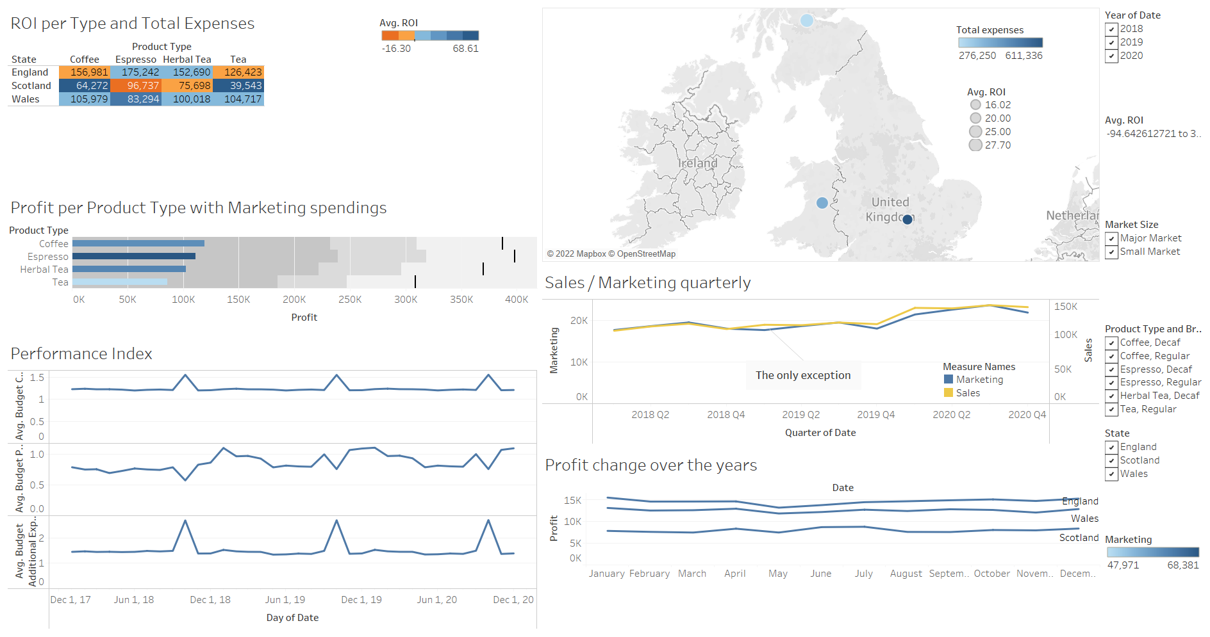
C Level Dashboard
Notes:
Here you can see the C level dashboard.

Slide 6
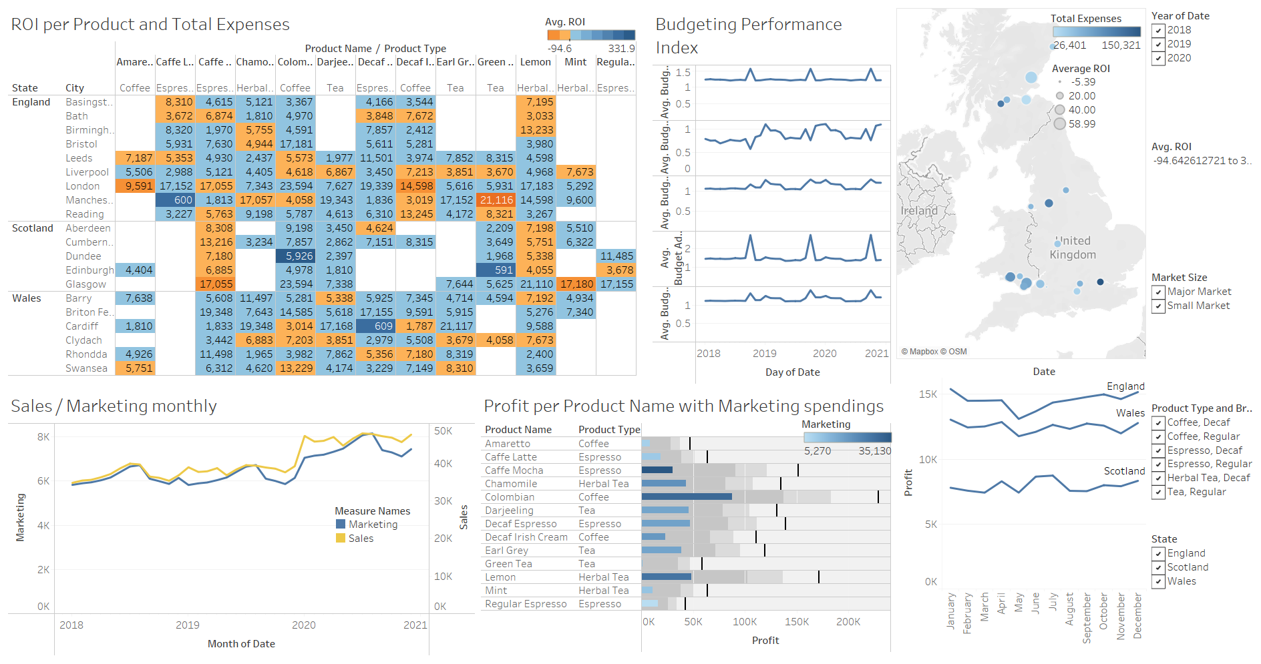
Managerial Dashboard
Notes:
And here is the managerial level dashboard. Now, let’s break the dashboard down.

Slide 7
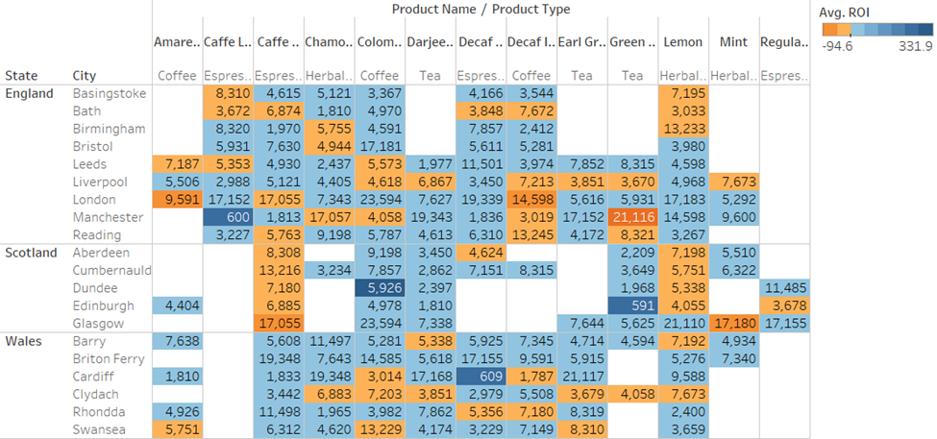
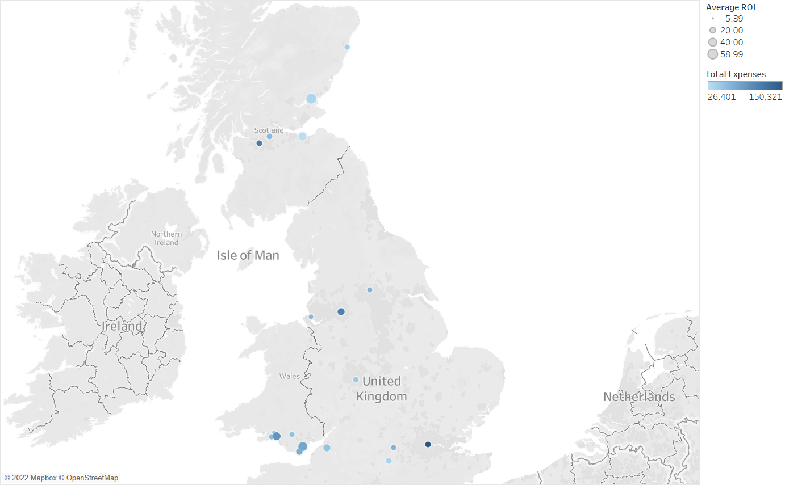
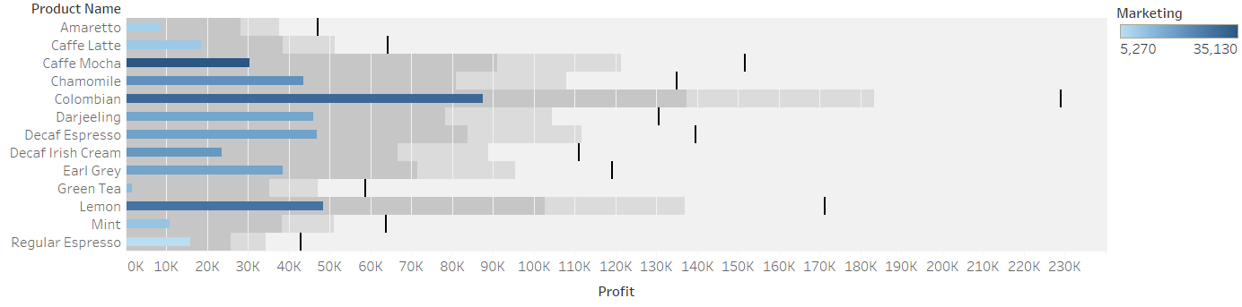
Section 1 - Current State
Notes:
In the first figure, we see a highlight table. The orange-blue diverging colour palette indicates the Return of Invenstent on a particular location and product. We can quickly gain an understanding about the sales situation in the brand in a few short moments. We can easily distinguish for example the consistently low ROI indicator on Scotland, especially in cafe late brews.
Next, the symbol map shows similar information on a geographic context, and finally, the third graph aims to examine the most profitable and popular products and their relation with the respective marketing expenses.
Plenty of conclusions can be derived by looking this graph, It can be obvious for example, that the Green Tea line of products is consistently below expectations for sales, and not particular responsive on marketing spending, something that can also be said for ‘Mocha’ and ‘Regular expresso’ products. In the contrary, ‘Chamomile’ and ‘Lemon’ are the company’s most popular and profitable products, and their marketing campaigns seems to have increased the sales significantly.

Slide 8
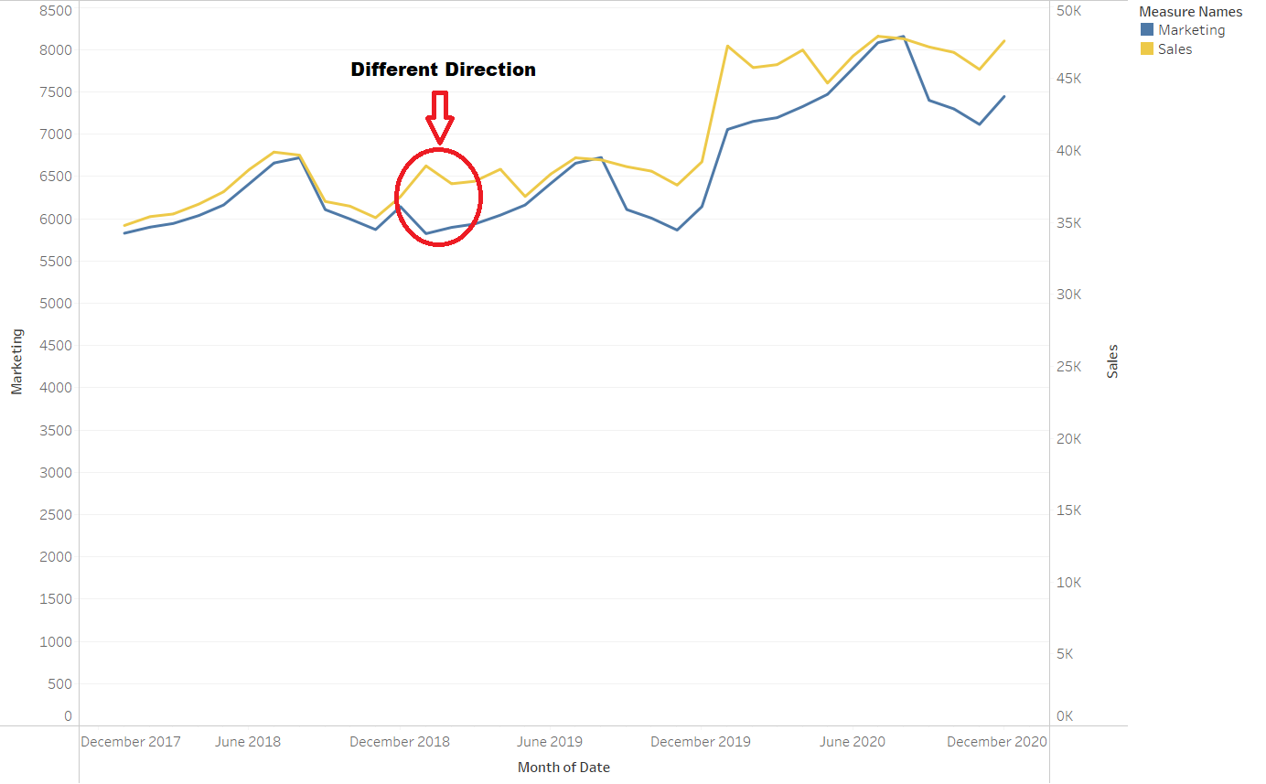
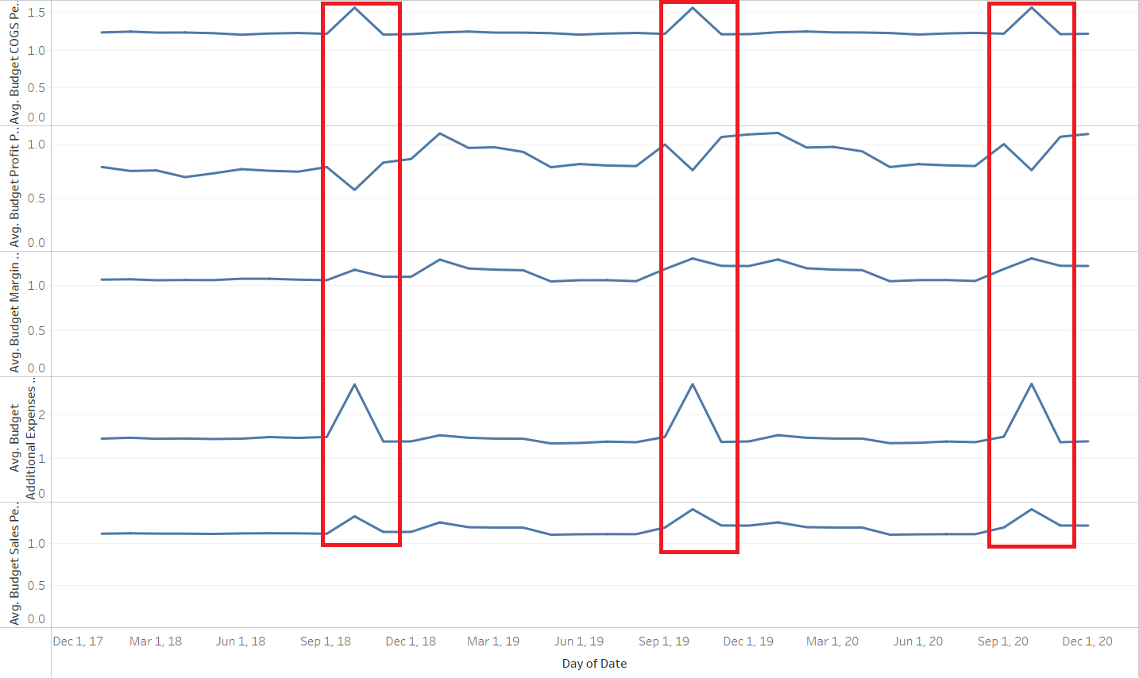
Section 2 - Trends
Notes:
Up next,lets discuss the company’s trends
It can be concluded that the company sales are consistently responsive on the marketing spending, and that can indicate that the current marketing strategies are working as expected. This of course is not universal and may be subject to market disruptions (such as holidays, summer, covid, etc). The marketing performance overall is great.
We can evaluate the companys budgeting performance by looking into the right graph, representing the budgeting performance over time. The budget planning processes is working great for most of the year, with a notable exception for the months immediately after the end of the summer season. The budgeting planning performance significantly drops during these months, by consistently overestimating ‘Additional Expenses’ and COGS, and underestimating profits.

Slide 9
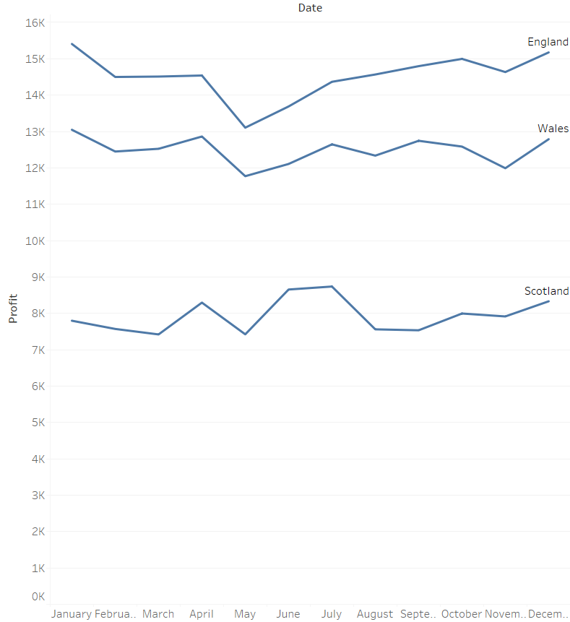
Section 3 - Forecast
The company is stagnated. The profit remains similar over the three years.
Notes:
Lets now move on the forecast section
It can be seen that profits remained constant for the last 3 years. That can be problematic as being stagnated means falling behind the competition. Every year the market is growing and Lupita’s cafe is not increasing its market share, therefore its market share is shrinking. If we take into account the yearly inflation rates, earning 16k on 2018 is not the same as earning 16k in 2020, decreasing the companies actual purchasing power even more. Our proposed course of action, for the company is to reconsider its sales strategies and plan ahead to solve the aforementioned problems.

Slide 10
Section 4 - What if Scenarios
The company has to investigate the budgeting issue after summer
The company has to use the marketing skills they possess in a way that will help them get out of the stagnation in profits
Notes:
Given our previous findings, the following suggestions are to be made
It is essential to re-evaluate the budgeting strategies and detect possible procedural errors, resulting in the reduced performance on after-the-summer period, this will increase the companies planning capabilities and potentially reduce its supply-chain strains
Resolving the stagnated sales problem as a long term strategic goal. It can be deduced from our findings that increased marketing spending leads consistently to increased sales, and increased sales is the key to get out of the stagnated sales situation. This can be considered as a priority as failing to address this issue early on, may lead reduced market share and purchasing power.

Slide 11
Conclusion
Overall the company is in good position
However, changes need to be made to get out of the stagnation
By integrating the recommendations in their short-term and long-term strategies they can fix the issues
Notes:
To conclude, we believe that Lupita’s café could greatly benefit from a business intelligence solution. By developing a prototype we were able to detect various problematic areas, their short and long term effects on the business, as well as to propose pragmatic and measurable solutions for a number of them. A BI solution will furnish a real-time evaluation platform to the business to find and test the ideal processes to follow, in order to steer itself into their rough but ever changing free market.

Slide 12
Lessons Learned
How we can construct a full, end-to-end, BI Process
The value that a BI solution can bring into any organization and business
How the appropriate visualization can communicate issues easier to non-technical audience
Notes:
For the lessons learned. Data visualization is a necessary process to every business and organization to deduce knowledge and insight by using pure data. Data visualization revolutionizes problem detection and prevention, as we can detect crucial problems and tackle them earlier, when their cost and effects can be easily managed. BI can follow very standard processes but we should always remember that every business and domain is different. Finally we learned how we can transform our results and findings into insight, ready to be consumed by non-technical people.

Slide 13
Thanks for watching
CREDITS: This presentation template was created by Slidesgo
Notes:
Thank you for watching (smile)

